Slide 1


A CENTER FOR INTER-DISCIPLINARY RESEARCH 2022-23
TITLE
SMART BLIND STICK
SUPERVISED BY
SAI GOPI , PRAGNA
GOKARAJU RANGARAJU
INSTITUTE OF ENGINEERING AND TECHNOLOGY AUTONOMOUS
1

Slide 2
Advanced Academic Center ( A Center For Inter-Disciplinary Research )
This is to certify that the project titled
SMART BLIND STICK
is a bonafide work carried out by the following students in partial fulfillment of the requirements for Advanced Academic Center intern, submitted to the chair, AAC during the academic year 2022-23.
RO
NAME | ROLL NO | BRANCH
RUPERAO VARUN | 21241A04J3 | ECE
DRITEKSHAN | 21241A0590 | CSE
2
2

Slide 3
This work was not submitted or published earlier for any study
Ms. Pragna | Dr.B.R.K.Reddy | Dr.G.Ramesh
Mr. Sai Gopi
Project Supervisors | Program Coordinator | Associate Dean,AAC
3

Slide 4
ACKNOWLEDGEMENTS
We express our deep sense of gratitude to our respected Director, Gokaraju Rangaraju Institute of Engineering and Technology, for the valuable guidance and for permitting us to carry out this project.
With immense pleasure, we extend our appreciation to our respected Principal, for permitting us to carry out this project.
We are thankful to the Associate Dean, Advanced Academic Centre, for providing us an appropriate environment required for the project completion.
We are grateful to our project supervisor who spared valuable time to influence us with their novel insights.
We are indebted to all the above mentioned people without whom we would not have concluded the project.
4

Slide 5
TABLE OF CONTENTS
1. ABSTRACT………………………………………….6
2. INTRODUCTION…………………………………....6
3. PROJECT WORKFLOW……………………………7
4. HARDWARE USED…………………………………7--8
4.1 ARDUINO NANO a000005 BOARD.........................................................7
4.2 ULTRASONIC SENSOR.............................8
4.3 PIEZO BUZZER.......................................8
5. SOTWARE USED…………………………………9
5.1 ARDUINO IDE……………………………9
6. CODE……………………………………………….10—11
7. References..................................................................11
8. CONCLUSION……………………………………12
9. FUTURE DEVELOPMENTS …………………….12
5

Slide 6
ABSTRACT
There are about 18.7 million blind people in india.This blind stick is an initiative to help the blind people and make them self reliant.
The main objective of this project is to design a smart dustbin which will help in keeping our environment clean and also eco friendly. We are using ultrasonic sensor to know the distance at which the obstacle is present.
Our system is built using Arudino nano, Ultrasonic sensor and buzzer.
INTRODUCTION
Blind stick is an innovative stick designed for visually disabled people for improved navigation. We here propose an advanced blind stick that allows visually challenged people to navigate with ease using advanced technology. The blind stick is integrated with ultrasonic sensor . Our proposed project first uses ultrasonic sensors to detect obstacles ahead using ultrasonic waves. On sensing obstacles the sensor passes this data to the microcontroller. The microcontroller then processes this data and calculates if the obstacle is close enough. If the obstacle is not that close the circuit does nothing. If the obstacle is close the microcontroller sends a signal to sound a buzzer.
6

Slide 7
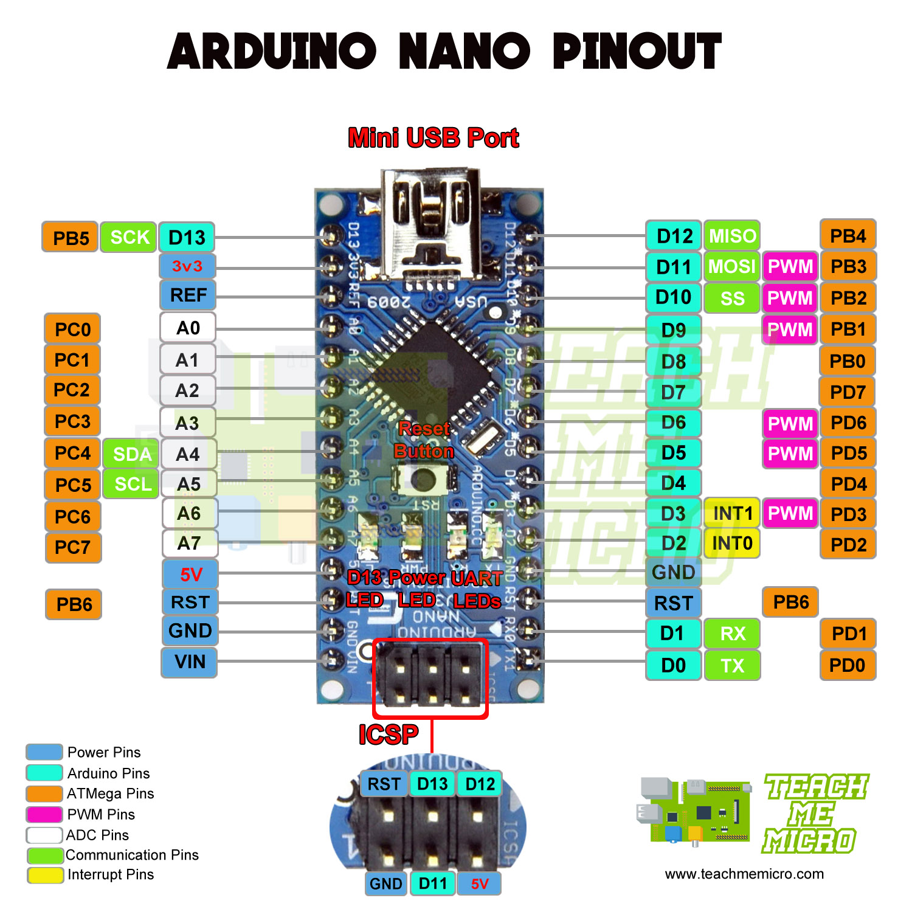
PROJECT WORK FLOW
The blind stick is switched on. The blind stick has an uv sensor and buzzer present on it. When an object is present within 50 cm the uv sensor immediately detects the object and send a message to the buzzer to buzz indicating an obstacle is present in the path.
HARDWARE USED
ARUDINO NANO a000005
Arduino Nano is one type of microcontroller board, and it is designed by Arduino.cc. It can be built with a microcontroller like Atmega328. This microcontroller is also used in arduino UNO. It is a small size board and also flexible with a wide variety of applications. Other Arduino boards mainly include Arduino Mega, Arduino Pro Mini, Arduino UNO, Arduino YUN, Arduino Lilypad, Arduino Leonardo, and Arduino Due. And other development boards are AVR Development Board, PIC Development Board, Rasberry pi, Intel Edison, MSP430 Launchpad, and ESP32 board.
This board has many functions and features like an Arduino Duemilanove board. However, this Nano board is different in packaging. It doesn’t have any DC jack so that the power supply can be given using a small USB port otherwise straightly connected to the pins like VCC & GND. This board can be supplied with 6 to 20volts using a mini USB port on the board.
ARUDINO NANO a000005
7

Slide 8
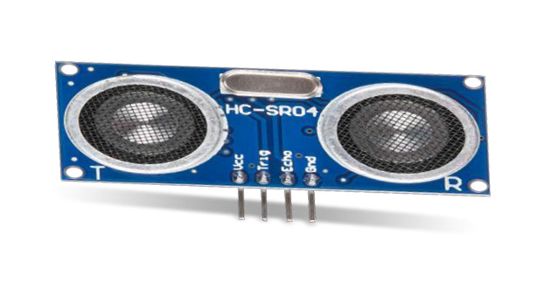
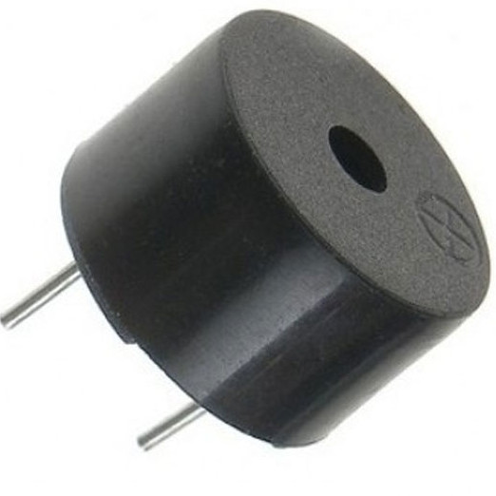
ULTRASONIC SENSOR
An ultrasonic sensor is an electronic device that measures the distance of a target object by emitting ultrasonic sound waves, and converts the reflected sound into an electrical signal. Ultrasonic waves travel faster than the speed of audible sound (i.e. the sound that humans can hear). Ultrasonic sensors have two main components: the transmitter (which emits the sound using piezoelectric crystals) and the receiver (which encounters the sound after it has travelled to and from the target). In order to calculate the distance between the sensor and the object, the sensor measures the time it takes between the emission of the sound by the transmitter to its contact with the receiver. The formula for this calculation is D = ½ T x C (where D is the distance, T is the time, and C is the speed of sound ~ 343 meters/second). Ultrasonic sensors are also used as level sensors to detect, monitor, and regulate liquid levels in closed containers (such as vats in chemical factories). Most notably, ultrasonic technology has enabled the medical industry to produce images of internal organs, identify tumors, and ensure the health of babies in the womb
ULTRASONIC
PIEZO BUZZER
In simplest terms, a piezo buzzer is a type of electronic device that’s used to produce a tone, alarm or sound. It’s lightweight with a simple construction, and it’s typically a low-cost product. Yet at the same time, depending on the piezo ceramic buzzer specifications, it’s also reliable and can be constructed in a wide range of sizes that work across varying frequencies to produce different sound outputs. Thanks to both the reliability and flexibility of piezoelectric vibration plates to produce audible signals — ranging from monotone buzzes and alarms to multi-tones and melodies — their applications in small, high-density assemblies are wide-ranging. What’s more: Their low power consumption makes them ideal for many battery-operated devices.
With such characteristics, piezo buzzers are regularly used in alarms, warning devices and automobile alerts. In addition, since they can produce a wide range of audible signals, they’re also used in pest deterrent devices. And in the consumer electronics field, some of their most popular applications include sound generators in computers, telephones, toys and games — to name just a few.
PIEZO BUZZER
8

Slide 9
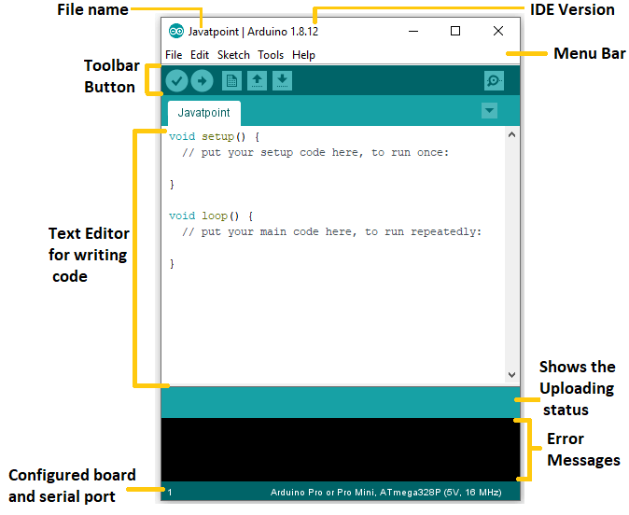

ARDUINO IDE
The Arduino Integrated Development Environment (IDE) is a cross-platform application (for Windows, macOS, Linux) that is written in functions from C and C++. It is used to write and upload programs to Arduino compatible boards. The Arduino board is connected to a computer via USB, where it connects with the Arduino development environment (IDE). The user writes the Arduino code in the IDE, then uploads it to the microcontroller which executes the code, interacting with inputs and outputs such as sensors, motors, and lights. Arduino serial monitor can be opened by clicking on the magnifying glass icon on the upper right side of the IDE or under tools. The serial monitor is used mainly for interacting with the Arduino board using the computer and is a great tool for real-time monitoring and debugging.
9

Slide 10
CODE
const int trigPin = 3;
const int echoPin = 2;
const int buzzer = 11;
long duration;
int distance;
int safetyDistance;
void setup() {
pinMode(trigPin, OUTPUT);
pinMode(echoPin, INPUT);
pinMode(buzzer, OUTPUT);
Serial.begin(9600);
}
void loop() {
digitalWrite(trigPin, LOW);
delayMicroseconds(2);
digitalWrite(trigPin, HIGH);
delayMicroseconds(10);
digitalWrite(trigPin, LOW);
duration = pulseIn(echoPin, HIGH);
distance= duration*0.034/2;
safetyDistance = distance;
if (safetyDistance <= 50){
digitalWrite(buzzer, HIGH);
}
else{
digitalWrite(buzzer, LOW);
}
Serial.print("Distance: ");
Serial.println(distance);
}
10

Slide 11
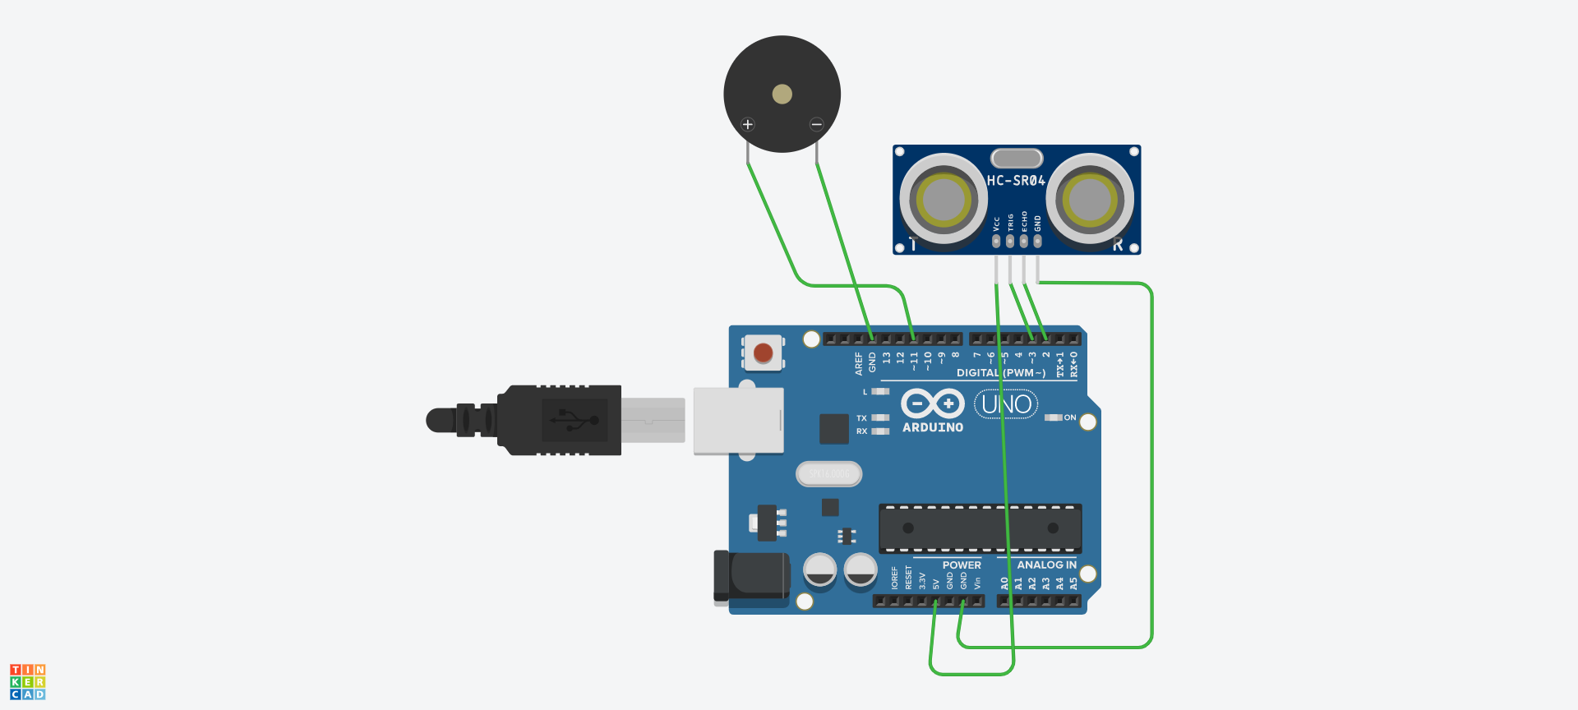
References
Blind people population in India
https://nevonprojects.com/ultrasonic-blind-walking-stick-project/
11

Slide 12
CONCLUSION
Blind stick helps in making a blind person self reliant. It consists of a uv sensor which help in detecting objects within a certain range . If it detects an object within certain range the buzzer buzzes immediately indicating the presence of an obstacle .
FUTURE DEVELOPMENTS
Including tracking live location of blind person using the stick.
.Including alarm feature to remind them about taking medicines at time.
Detecting water puddles
12

